Slide 1
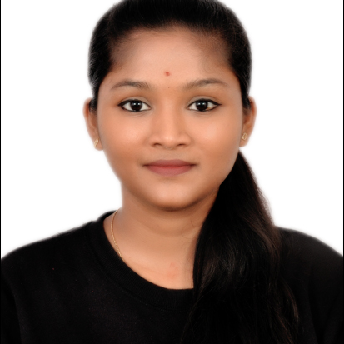
SHAMITA N M
Analyst/Software Engineer
Bachelor of Computer Science and Engineering:2017-2021
Skills
Bangalore
Core Java | OOPS concepts, Exception Handling, Generics, Collection Framework, Annotations.
Spring Boot | JUnit5 and Mockito, Maven, REST API’s, Spring Security, Rest Microservices, HTTP.
UI Framework-React | Fundamentals components ,Java Script, Working with states & props in React , Routing ,Life Cycle Method, Working with HTTP in React.
React | Components, Services, Modules, Routing, Forms & Validation.
Database | MongoDB
UI Tech | HTML 5 & CSS 3,JavaScript.
Tools | Visual Studio 2019, Visual Studio code, Swagger, Postman, STS.
Add On skills | Communications, Team management. Peer learning
Shamita.n-m@capgemini.com
+91 7899054907
A4
Proficient in JAVA and OOPs concepts.
Hands on experience in creating Web Application with JAVA Spring Boot, Web API, React.
Hands on experience in developing web pages using HTML5, CSS3, Object Oriented Programming. Good understanding of Document Object Model (DOM) and DOM Functions.
Practical understanding of rendering Java Spring Boot, REST API.
Proficient React developer with working knowledge on React.
Implemented Web API and React in case study and up skilling this knowledge continuously.
Railway Reservation System
Working on end-to-end case study of Railway Reservation Application along with authentication, Swagger and React used for user interface.
Java and React for web developers in Degreed Platform
Completed this course with optimal Knowledge of Spring ,Web API , RESTful services , Components.
Railway Reservation System
Developed Railway Reservation using Frontend react and Backend Spring Boot Web API with Mongo as Database .

